Slide 1

XML
PREPARED BY AMBREEN MEHMOOD

Slide 2
XML (Extensible Markup Language) is a markup language similar to HTML, but without predefined tags to use. Instead, you define your own tags designed specifically for your needs. This is a powerful way to store data in a format that can be stored, searched, and shared

Slide 3
Difference Between XML and HTML
XML | HTML
The full form is eXtensible Markup Language | The full form is Hypertext Markup Language
The main purpose is to focus on the transport of data and saving the data | Focusses on the appearance of data. Enhances the appearance of text
XML is dynamic because it is used in the transport of data | HTML is static because its main function is in the display of data
It is case sensitive. The upper and lower case needs to be kept in mind while coding | It is not case sensitive. Upper and lower case are of not much importance in HTML
You can define tags as per your requirement but closing tags are mandatory | It has its own pre-defined tags and it is not necessary to have closing tags
XML can preserve white spaces | White spaces are not preserves in HTML
eXtensible Markup Language is content-driven and not many formatting features are available | Hypertext Markup Language, on the other hand, is presentation driven. How the text appears is of utmost importance
Any error in the code shall not give the final outcome | Small errors in the coding can be ignored and the outcome can be achieved
The size of the document may be large | No lengthy documents. Only the syntax needs to be added for best-formatted output

Slide 4
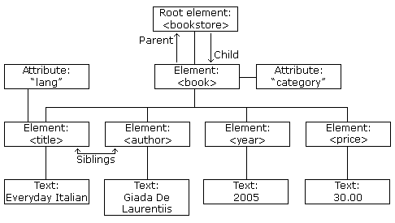

Slide 5
XML Schema is commonly known as XML Schema Definition (XSD). It is used to describe and validate the structure and the content of XML data. XML schema defines the elements, attributes and data types. Schema element supports Namespaces. It is similar to a database schema that describes the data in a database.
Syntax
You need to declare a schema in your XML document as follows −

